Slide 1
final project HOUNDS AND HARE
name：Shunlei Ning
Qianqian Chen

Slide 2
how to play
1）There are two players, one representing the hounds and the other represents the hare. Each player takes turn to make a move. The player representing the hounds can only move one hound at one time.
2）The three hounds try to corner the hare and the hare tries to escape to the left of all hounds.
3）The hounds can move up and down, straight forward, or diagonally forward toward the right end of the game board. The hare can move horizontally, vertically, or diagonally in any direction.
4）The hounds win if they "trap" the hare so it can no longer move.
5）The hare wins if it "escapes" to the left of all three hounds.
6）variant If the hounds move vertically ten times in a row, they are considered to be "stalling" and the hare wins.

Slide 3
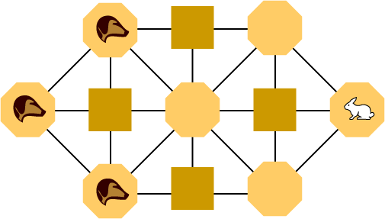
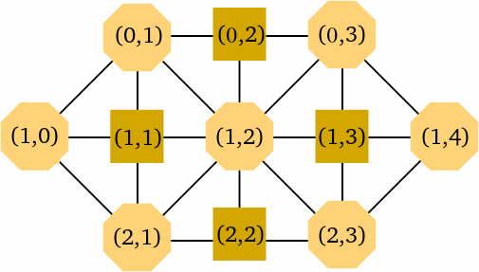
\

Slide 4
1. Ningshunlei and Chen qianqian completed the task of demand analysis together
2. Ningshunlei completed the overall analysis in the specific demand analysis, the tasks of hounds&hare and game development members and the specific task completion date as well as the specific assignment, initialization, main loop control module, etc
3. Ningshunlei and Chen qianqian jointly completed the parts of player movement, disk surface analysis, opponent movement, winner and loser judgment in the specific demand analysis
4. Chen qianqian completed the task of the functional module diagram of the specific functional description and part of the functional description diagram
5. Ningshun lei and Chen qianqian completed the detailed system design flow chart together, and the contents of the flow chart were explained
6. Ningshunlei and Chen qianqian jointly completed the content of specific program test results
7. Ning shunlei and Chen qianqian jointly completed the initialization program task in the source code of the specific hounds&hare game
8. Ning shunlei and Chen qianqian can jointly complete the procedures related to player movement in the specific source code
9. Ningshun lei, Chen qianqian complete the game source code disk, mobile type of related programming tasks together
10. Complete the game using Python3

Slide 5
Hounds and Hare游戏开发具体任务的具体分配
1.宁顺磊和陈倩倩共同完成需求分析任务
2.宁顺磊完成具体的需求分析中的总体分析，hounds&hare与游戏开发成员和具体任务完成日期以及任务的具体分配，初始化，主循环控制模块等部分内容的任务
3.宁顺磊，陈倩倩共同完成具体的需求分析中的玩家移动，盘面分析，对方移动，胜负判断等部分内容
4.陈倩倩完成具体的功能描述的功能模块图，功能说明图部分内容的任务
5.宁顺磊，陈倩倩共同完成具体的系统设计流程图，流程图说明部分的内容任务
6.宁顺磊，陈倩倩共同完成具体的程序测试结果部分的内容
7.宁顺磊，陈倩倩共同完成具体的hounds&hare游戏源代码中的初始化程序任务
8.宁顺磊，陈倩倩共同能完成具体的源代码中的玩家移动的有关程序
9.宁顺磊，陈倩倩共同完成游戏源代码的盘面，移动类型的有关程序任务
10.用Python3完成这项游戏

Slide 6
Difficult development challenge
1.需求分析
内容包括：总体分析，hounds and hare游戏与游戏开发成员和具体任务以及任务具体分配，初始化，主循环控制模块，玩家移动，盘面分析填写模型表，对方移动，胜负判断。
2.技术线路
内容包括：采用的软件以及开发平台是什么
项目的总体方案-包括模块及模块之间的联系，信息流，数据流等
项目的详细设计-包括模块的功能，数据结构及算法等
3.系统设计
内容包括：流程图，流程图说明
4.程序测试分析
6.源代码
7.(数据储存)不知道运行出来的数据如何储存

Slide 7
1. Demand analysis
Content includes: overall analysis, hounds and hare games and game development members and specific tasks as well as task specific allocation, initialization, main cycle control module, player movement, disk analysis filling model table, opponent movement, winner and loser judgment.
2. Technical circuit
Content includes: what is the software adopted and the development platform
Overall program of the project - including modules and the connections between modules, information flow, data flow, etc
Detailed design of project - including module function, data structure and algorithm
3. System design
Content includes: flow chart, flow chart description
4. Program test and analysis
6. The source code
7. Do not know how to store data after compile in the solver

Slide 8
strategy
Analysis ：
With perfect play, no matter who goes first the game is a win for the hounds！！
you also need to use common sense: never make a move that will
put you in jeopardy of losing. If you find yourself
in a bad spot, back up and practice the moves
you made that brought you to that position.

Slide 9
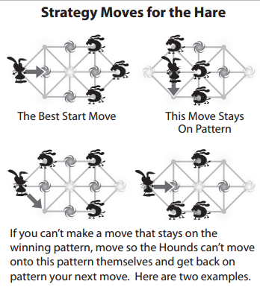
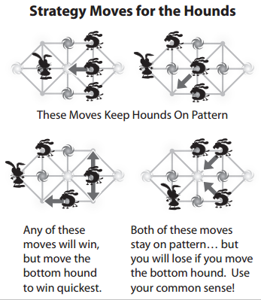

Slide 10
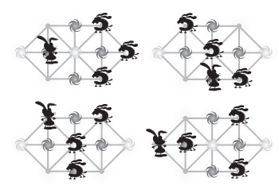
If you follow this pattern throughout the game, you
will most likely win. This strategy works for both
the Hare and the Hounds

Slide 11
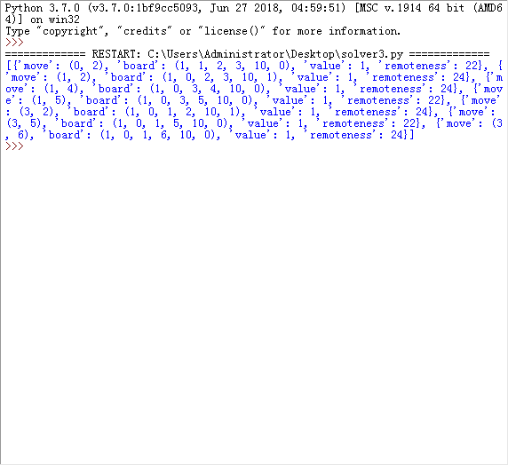
Solver position=32768 upperbound=277，200

Slide 12
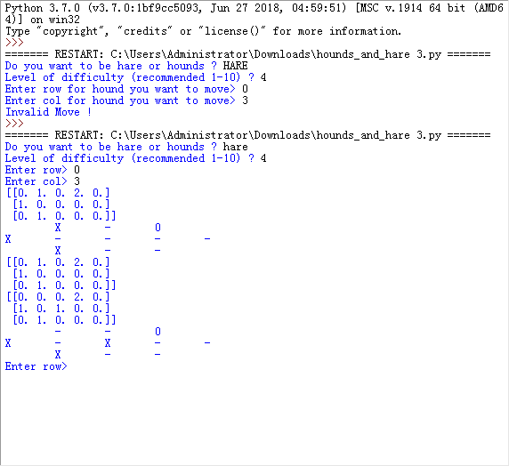
Human-Computer

Slide 13
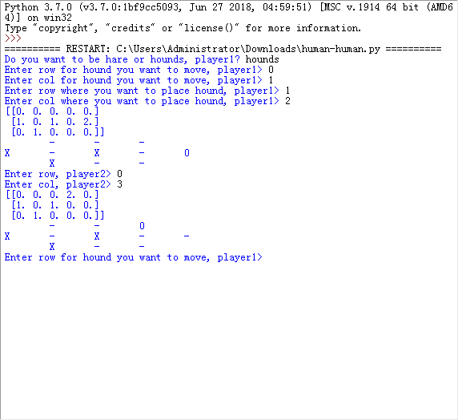
Human-human

Slide 14
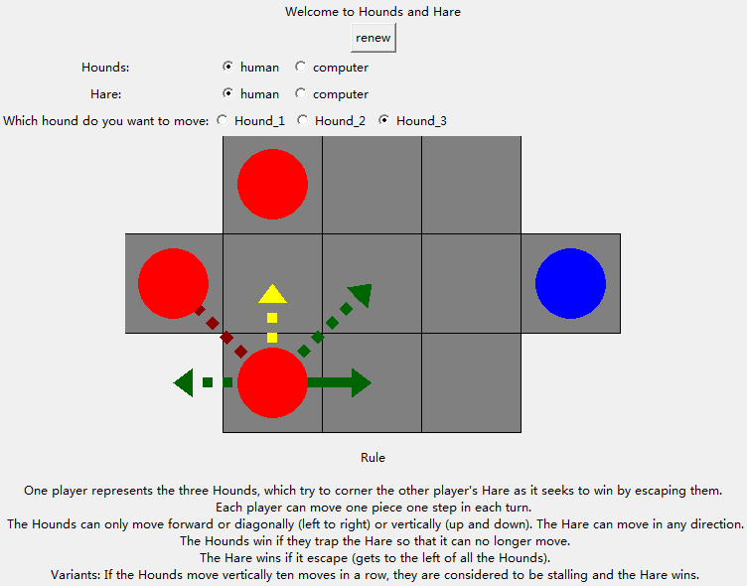
GUI

